Slide 1
Unit -5
Chapter -8
Dynamic Documents with JavaScript

Slide 2
*What is DHTML?
DHTML, or Dynamic HTML is collection of technologies used together to create interactive and animated web sites by using a combination of static markup language(such as HTML) , a client-side scripting language (such as JavaScript) , a presentation definition language( such as CSS) and the DOM.
DHTML = HTML+CSS+JAVASCRIPT+DOM

Slide 3
**Positioning Elements:
It is one of the important features of CSS that is having the ability to position the elements.
The CSS positioning properties allow you to position an element anywhere in your document.
You can put any HTML element at whatever location you like.
The position property specifies the type of positioning method used for an element.
This feature makes it possible to move objects to different sections of a page, move text and images, create animation etc.,

Slide 4
*Types of positioning
The different values for position property are:
Static
Relative
Absolute
Fixed
Default value: static
Elements can be positioned using the top, bottom, left, and right properties. But, these properties will not work unless the position property is set first.

Slide 5
The position property indicates that an element is to be positioned , and specifies which positioning method should be used.
Static
HTML elements are positioned static by default.
This is normal positioning scheme in which elements are positioned as they occur in the normal document flow.
An element with position: static; is not positioned in any special way; it is always positioned according to the normal flow of the page.

Slide 6
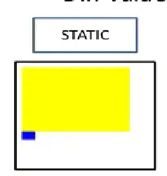

Slide 7

Relative
Relative positioning places the element in a position relative to the element where it is defined within the document(relative to the normal position).
The relative positioning property is used to set the element relative to its normal position.
It is defined as position: relative;
The two values top and left along with position property to move an HTML element anywhere in HTML document.
Ex:
<p>This example shows how relative positioning works.</p>
<div style="position: relative; left: 80px; top: 2px; background-color: yellow ;">
This div has relative positioning.
</div>

Slide 8
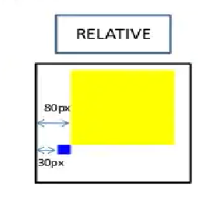

Slide 9
Absolute:
The absolute positioning is used to position an element relative to the parent element.
It is defined as position: absolute; .
The two values are top and left.
With the absolute positioning, you can place an element anywhere on a page.

Slide 10
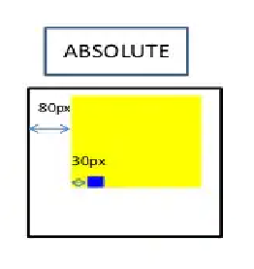

Slide 11
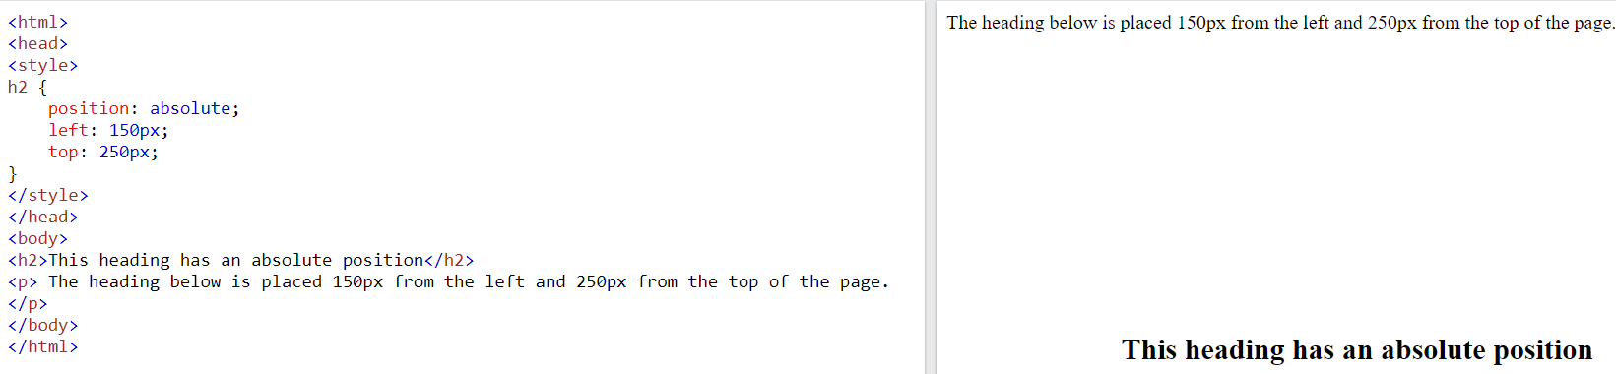

Slide 12
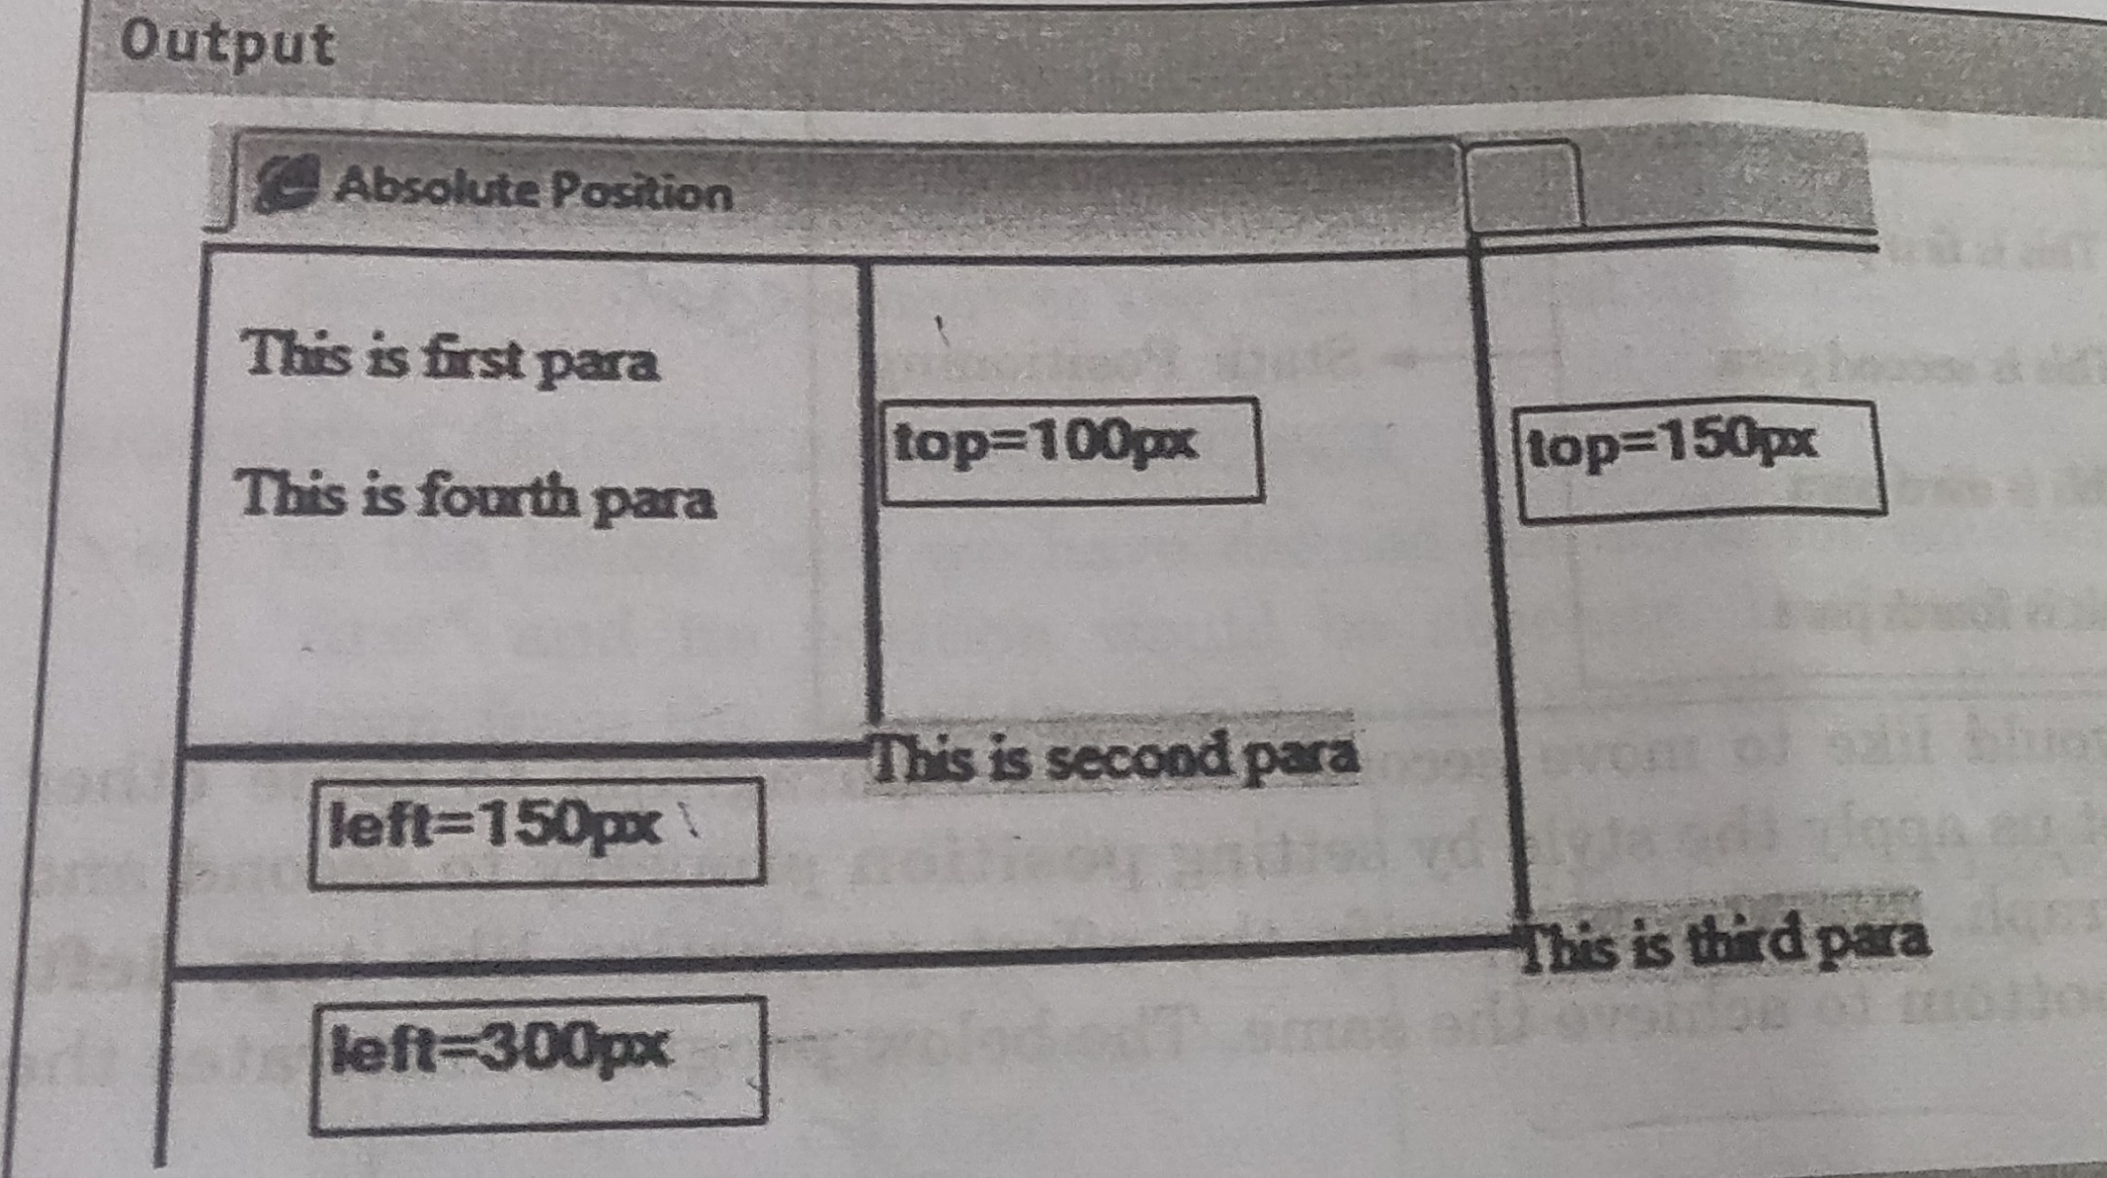

Slide 13
Fixed
Fixed positioning allows you to fix the position of an element to a particular spot on the page - regardless of scrolling.
It is defined as position: fixed; .
Which means it always stays in the same place even if the page is scrolled. The top, right, bottom, and left properties are used to position the element.

Slide 14
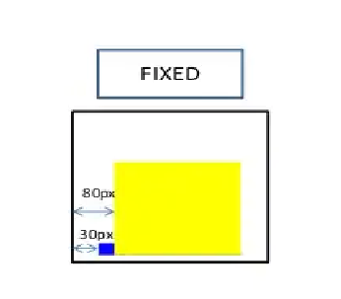

Slide 15
Specifying position:
Once we established the positioning method, the actual position is specified with 4 offset properties:
top, right, bottom, left
The values provided for each of the offset properties defines the distance the element should moved away from that respective edge.

Slide 16
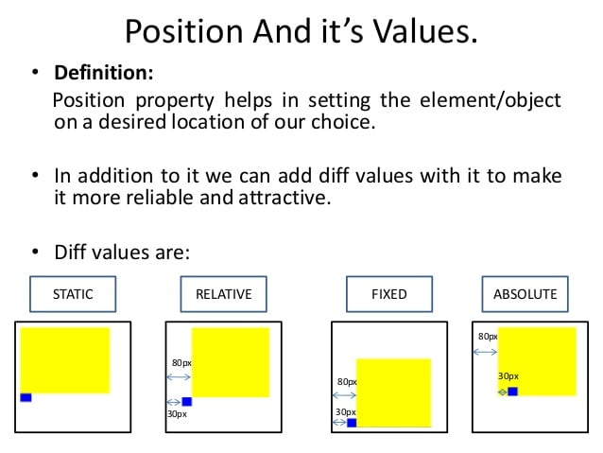

Slide 17
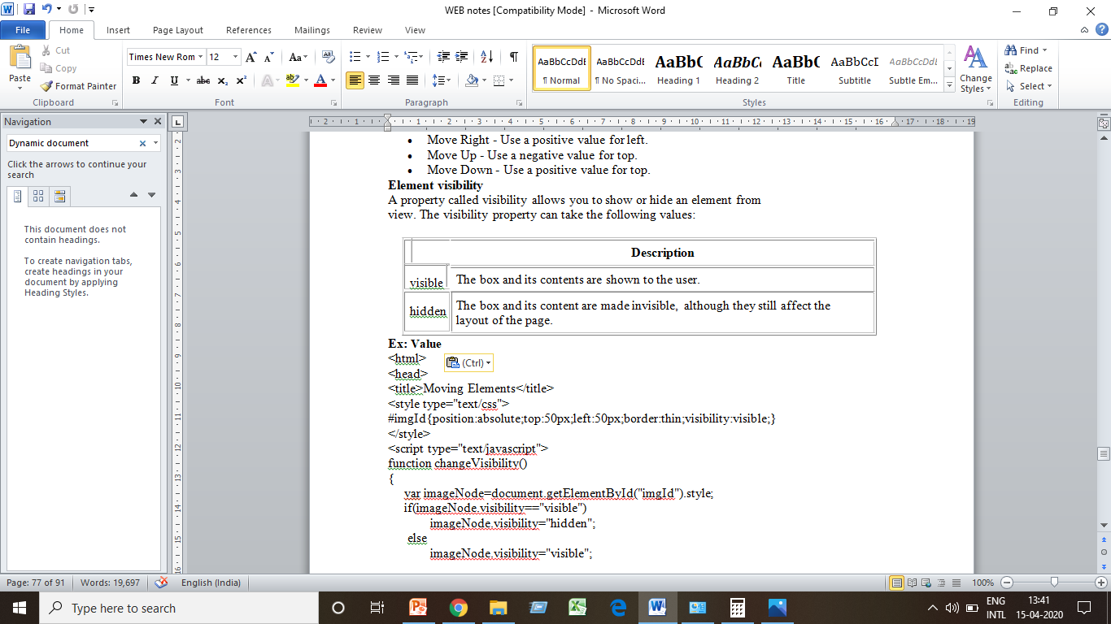
Element visibility
A property called visibility allows you to show or hide an element from view. The visibility property can take the following values:

Slide 18
Changing colors Dynamically
We know to set background & foreground colors. Lets see how to change colors dynamically based on the input values.
The javascript function onchange can be used to change dynamically.
eg: <body name="background" id="bg" color=“blue” onchange="changeBg(red)">

Slide 19
Dynamically Changing Fonts:
Suppose in a paragraph we have certain text.
Whenever the mouse is placed on the text of the paragraph, the font should change.
And whenever the mouse is moved out from the paragraph the font should change again.
That is called Dynamically changing font and it is possible with the help of onMouseOver and onMouseOut event handlers.
Eg: <p id="para" onMouseOver="bigFont();" onMouseOut="smallFont();">

Slide 20
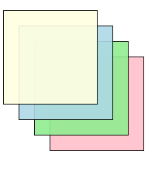
Stacking elements
When we move the elements using absolute and relative positioning, there are chances of overlap of the elements.
So it follows the chances of stack up the elements one on the other.
So we can change the stacking order with z-index property.

Slide 21
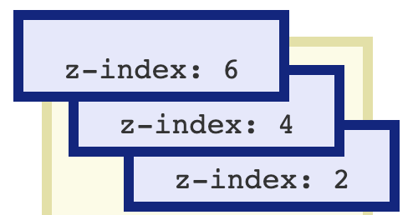
The z-index attribute determines which element is in front and which are covered by the front element.
To change stacking order, the handler function must change the z-index property value of the element.
Eg: if 3 images first image & second image,third image
firstimage.zindex = “6";
secondimage.zindex = “4";
thirdimage.zindex = “2";

Slide 22
Slow movement of the elements
Movement of the images can happen instantly.
But if we wish to move our images slowly then?
The window object provides two methods.
→ setTimeout()
→setTimeInterval()

Slide 23
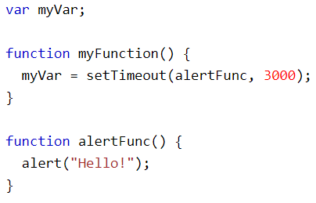
The setTimeout() The setTimeout() method calls a function or evaluates & stop execution of an expression after a specified number of milliseconds. The function is only executed once.
Syntax:
setTimeout(function, milliseconds);
Function-. The function that will be executed.
milliseconds. The number of milliseconds to wait before executing the code.

Slide 24
The setTimeInterval() - The setTimeInterval() method calls a function or evaluates an expression at specified intervals (in milliseconds)..
Syntax
setTimeInterval(function, milliseconds);
Function- The function that will be executed.
Milliseconds- The intervals (in milliseconds) on how often to execute the code.
EG:
myVar = setTimeInterval(alertFunc, 3000);

